Slide 1
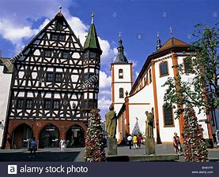
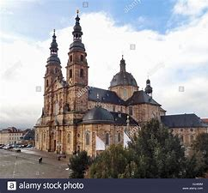
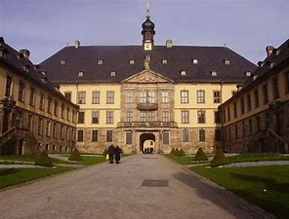
City Survival Guide
Fulda
Notes:
Philipp

Slide 2
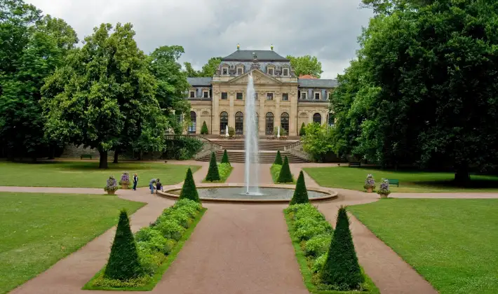
Disclaimer
The tips, recommendations and advice in this presentation are based on our own experience/opinion.
We do not want to give special ratings, but we want to provide a pleasant stay with all the beautiful aspects of Fulda, especially away from the typical touristy spots.

Slide 3
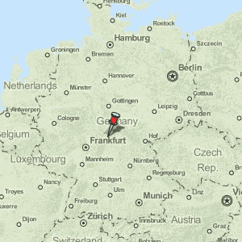
Fulda – the geographical center of Germany

Slide 4
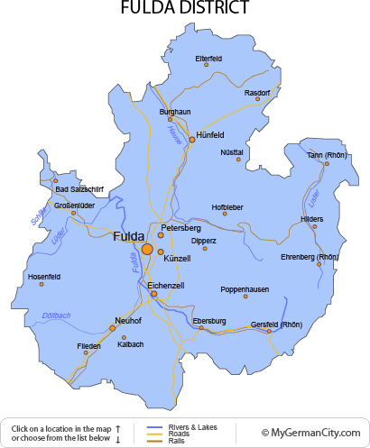
Fulda – Map

Slide 5
Quick Facts
68.000
City in Hesse
With around 150 ICE stops per day, Fulda has become one of the most important hubs in the Germany-wide rail network.
The foundation stone for the city of Fulda and the settlement of the region was laid on March 12, 744.
The river Fulda flows through Fulda

Slide 6
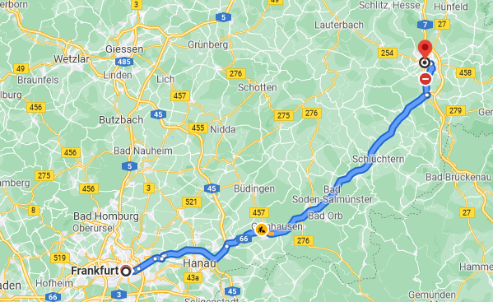
Getting to Fulda
Arriving at Frankfurt Airport
Taking the S-Bahn from the airport to Frankfurt Hauptbahnhof
Taking a direct train to Fulda

Slide 7
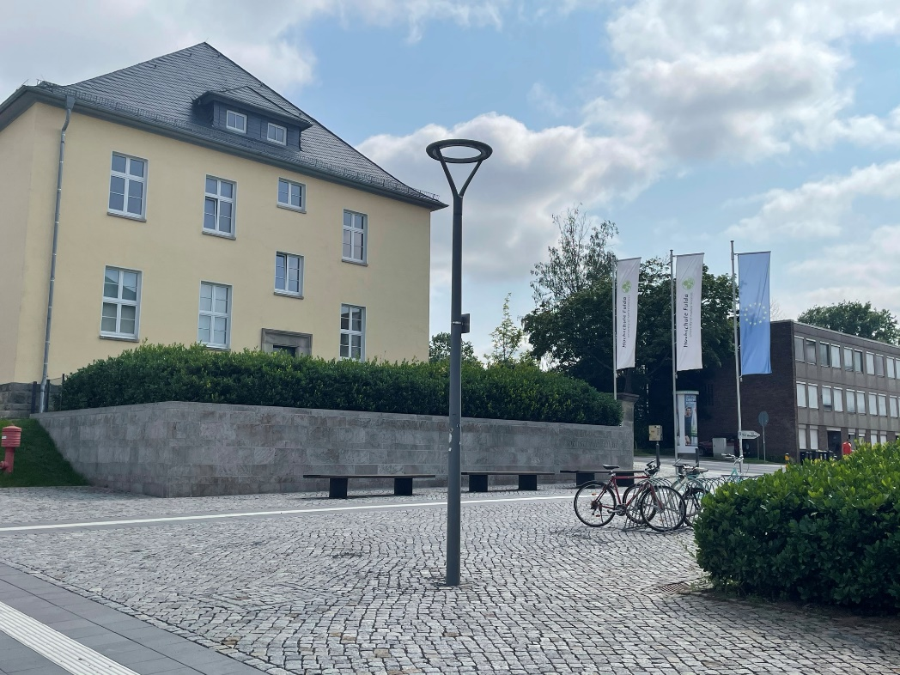
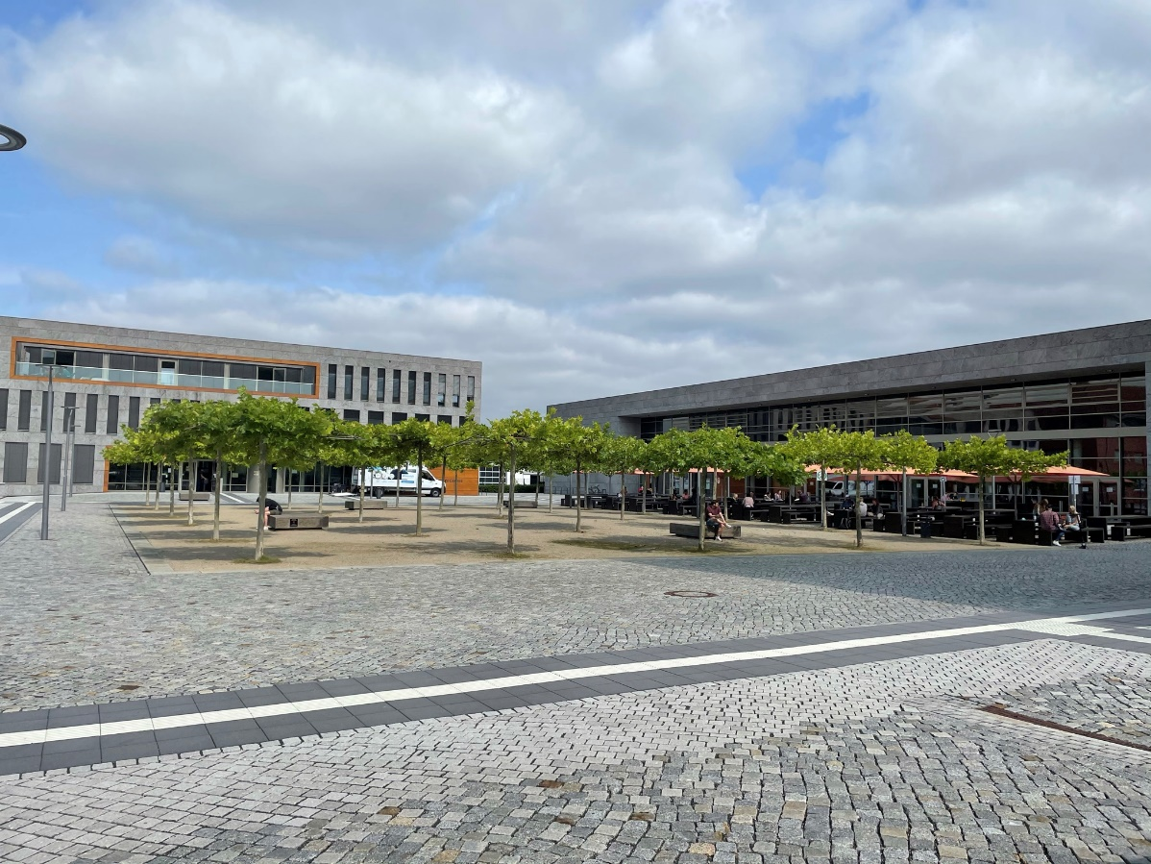
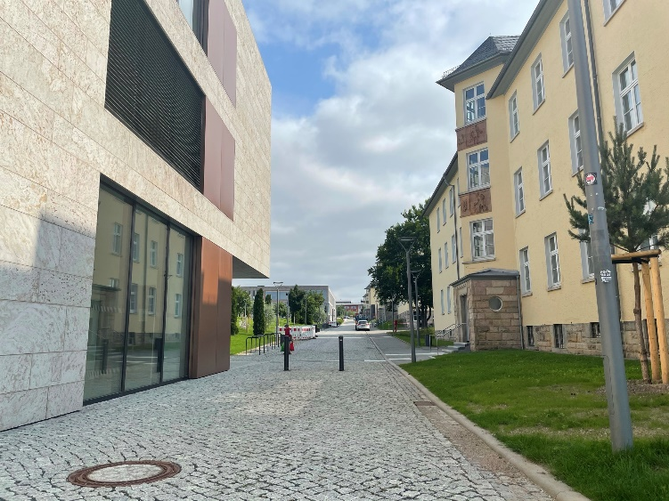
Hochschule Fulda

Slide 8
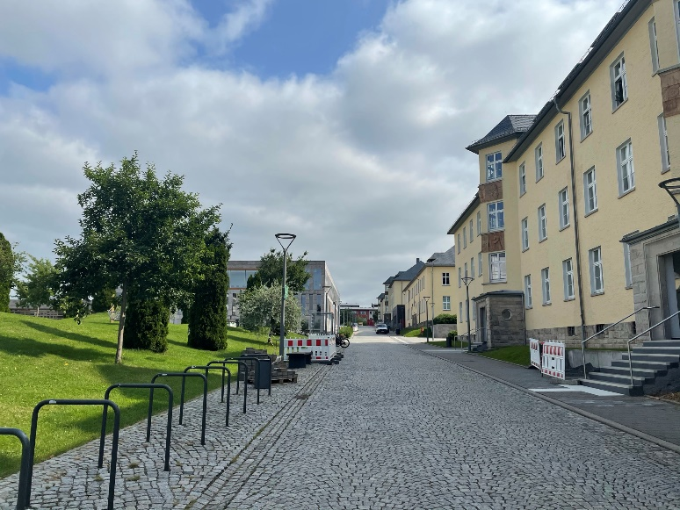
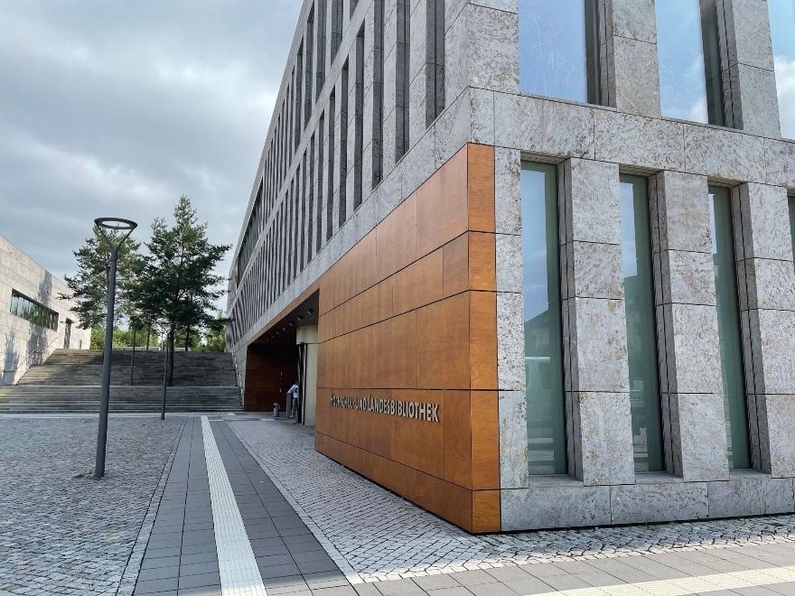
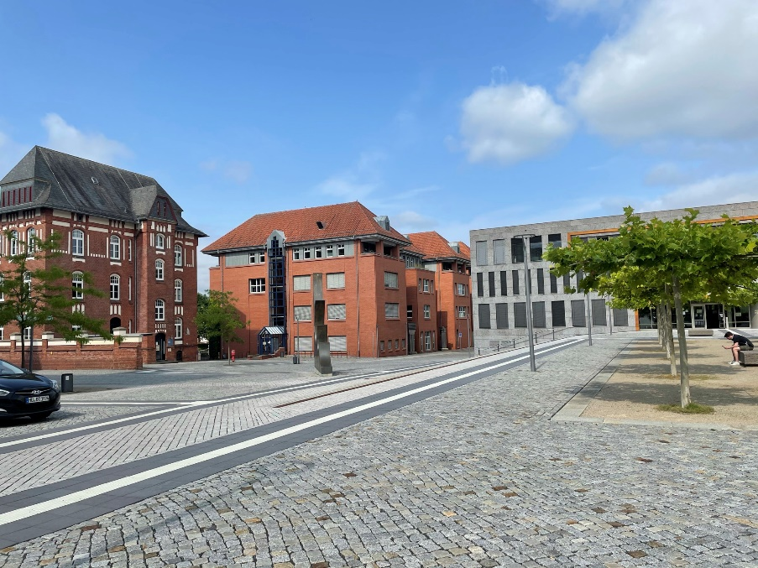
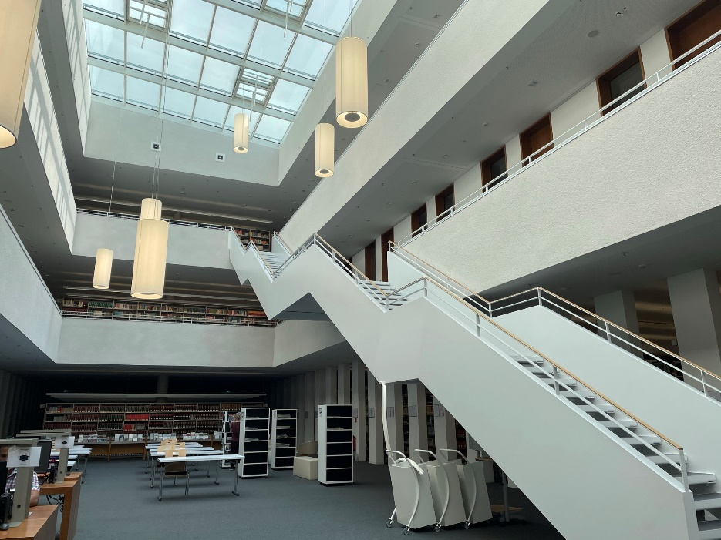
Campus

Slide 9
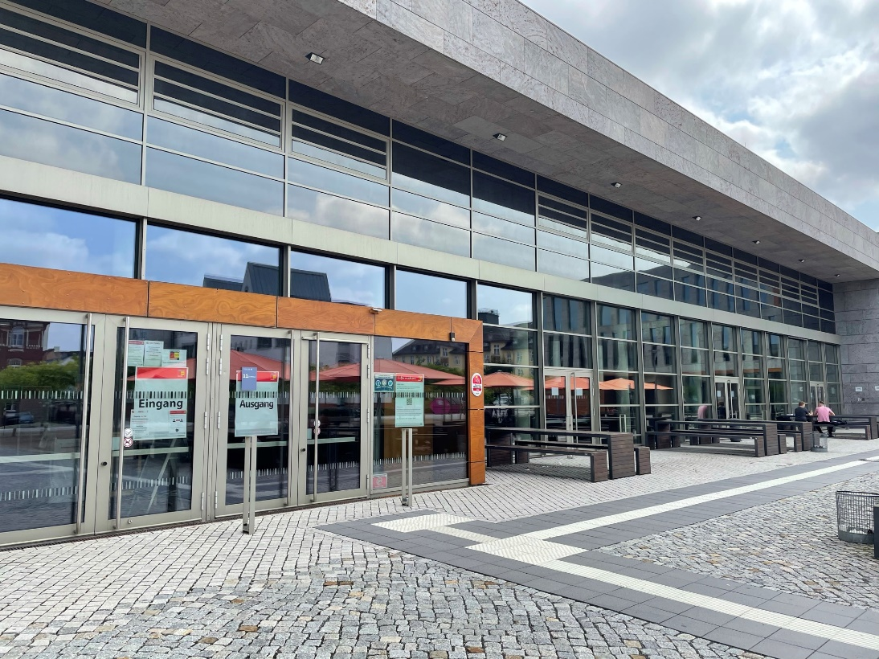
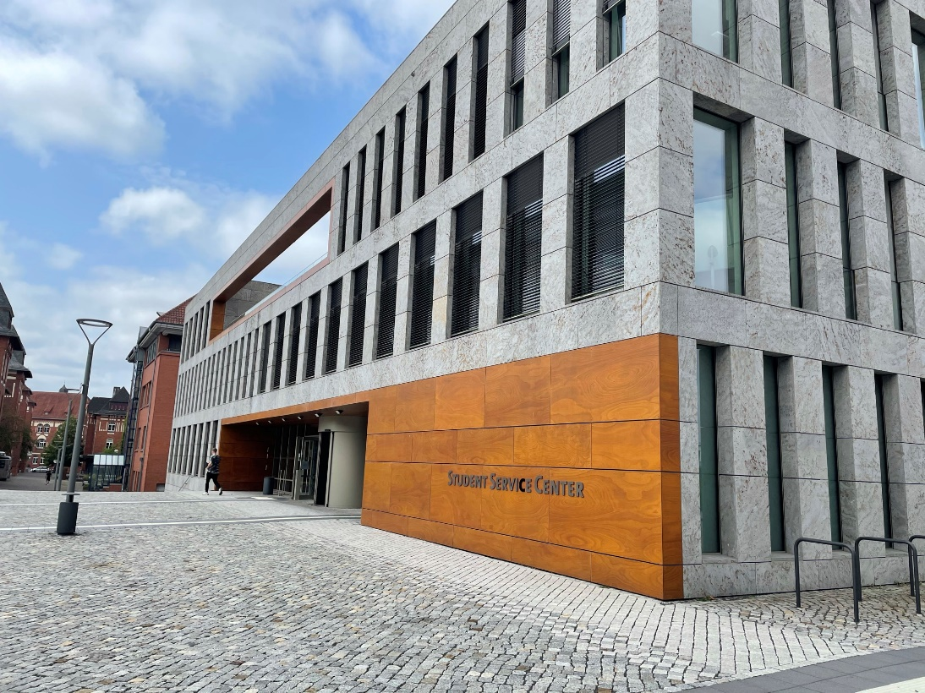
Campus
The Mensa offers different menus. The weekly meal plan can be found here: https://www.studentenwerk-giessen.de/essen-trinken/fulda/mensa-hochschule-fulda.html
If you need any help with anything, you can go there. Also, the international office is in this building.

Slide 10
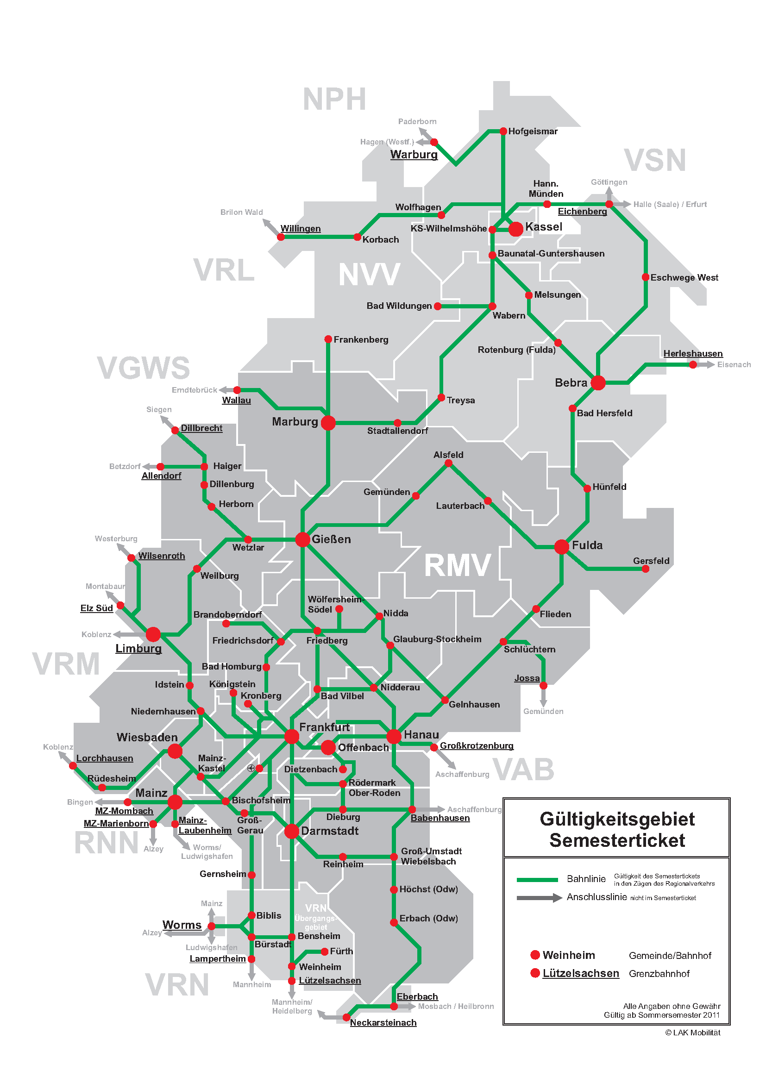
Semesterticket
Use your semester ticket to explore Hessen for free!

Slide 11
Culture & Sport
Stadt Fulda publishes all events that are taking place in Fulda (https://www.fulda.de/kultur-freizeit.html)
Wohnzimmer – Welcome In is a cultural and meeting center
volunteers with and without refugee experience welcome people from everywhere
Diverse program and everyone can contribute to it
Hochschule Fulda offers a diverse sport program each semester
https://www.hs-fulda.de/unsere-hochschule/a-z-alle-institutionen/hochschulsport/

Slide 12
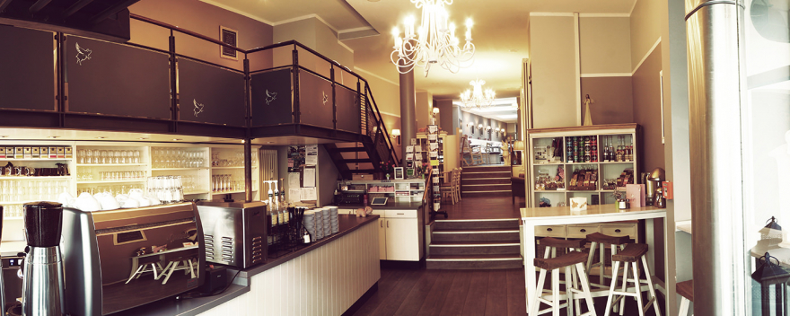
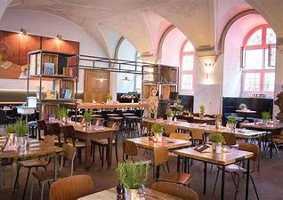
Restaurants and Cafés
A lot of cafés and restaurants are downtown (area around Universitätsplatz which is close to the train station)
Café Glück serves great and diverse breakfasts
Antons meet & eat is an „inclusive“ restaurant because people with and without disabilities work there
They offer a variety of meals with potatos but also breakfast
Alte Schule – Kaffee/Kiosk/Bar
a nice place to meet friends in the evening

Slide 13
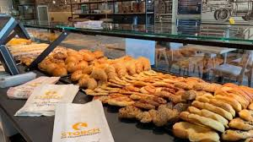
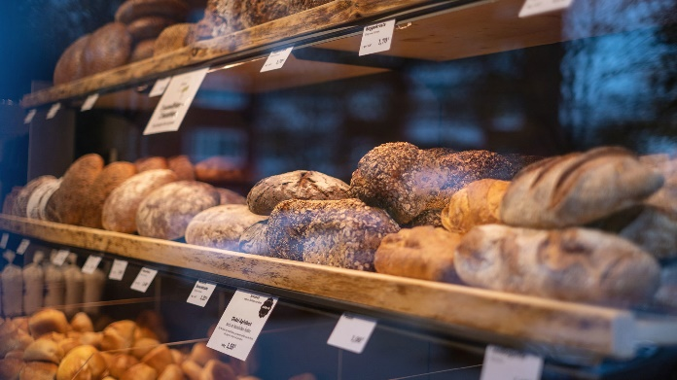
Other food related tipps
In case you are craving for Arabic food, here are three options where you can find Arabic products/food in Fulda
Anadolu Supermarkt (Turkish supermarket)
Jaad the Shawarma House
Alasil Geschmack Manakish
Also, do not forget to check out German bakeries!
Fulda has 2 so-called „Vortragsbäckereien“ (one in downtown and one next to the Hochschule) where they sell the bakery products from the previous day at half price (Bäckerei Happ and Bäckerei Storch)

Slide 14
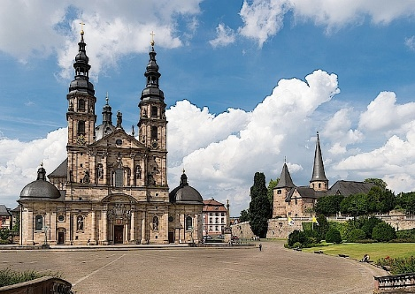
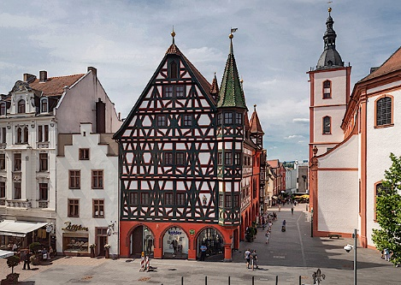
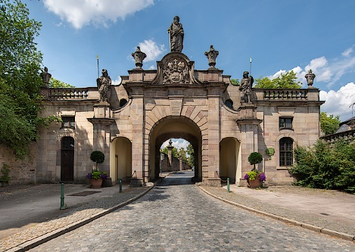
Typical must sees
Fulda Dom
Schlossgarten, Orangerie und Floravase
Barockviertel
Altstadt

Slide 15
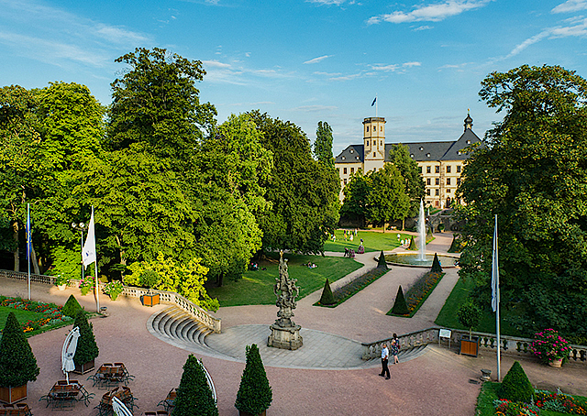
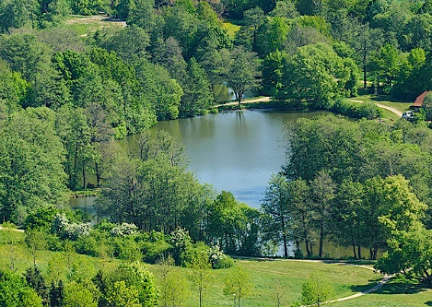
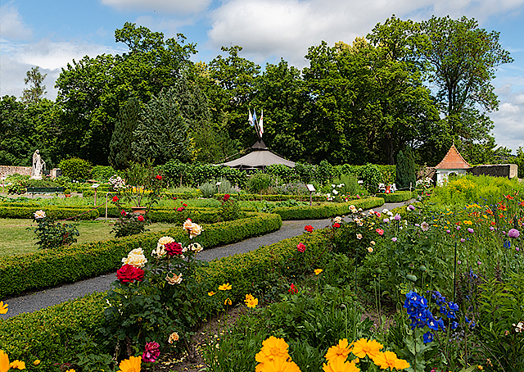
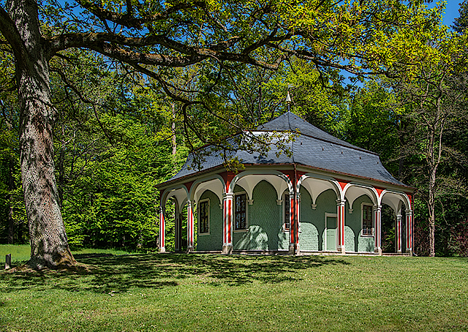
Parks & Gardens
Schlossgarten
Dahliengarten
Domdechaneigarten
Klostergarten Abtei St. Maria
Klostergarten Kloster Frauenberg
Park Schloss Fasanerie
Nah-Erholungsgebiet Fulda-Aue

Slide 16
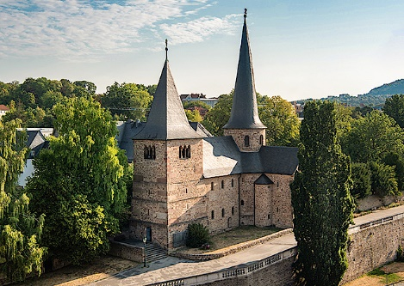
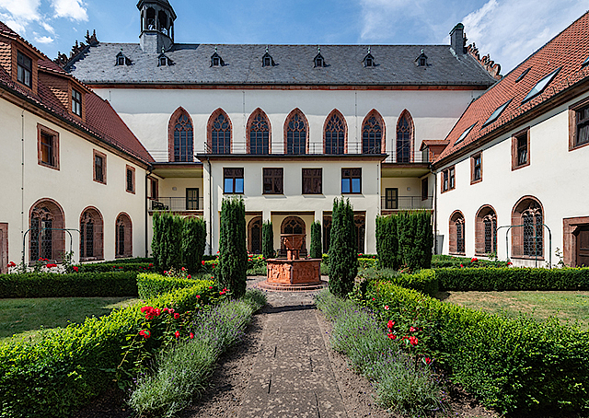
Churches and Museums
Stadtschloss - Historische Räume
Vonderau Museum
Dommuseum – Schatzkammer des Doms
Museum Schloss Fasanerie
Dom
Michaelskirche
Stadtpfarrkirche St. Blasius
Abtei St. Maria
Christuskirche
Kloster Frauenberg
Propstei St. Andreas
Propstei St. Peter

Slide 17
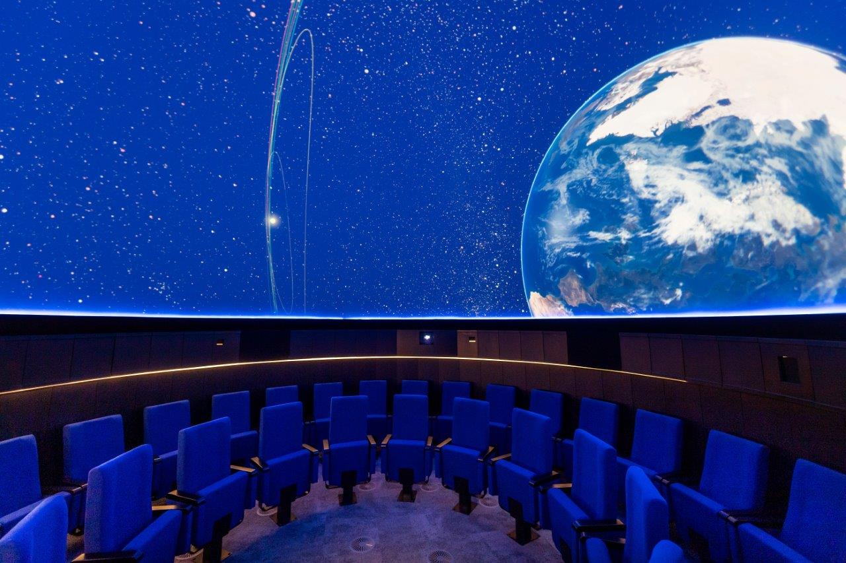
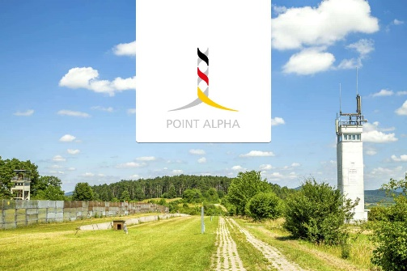
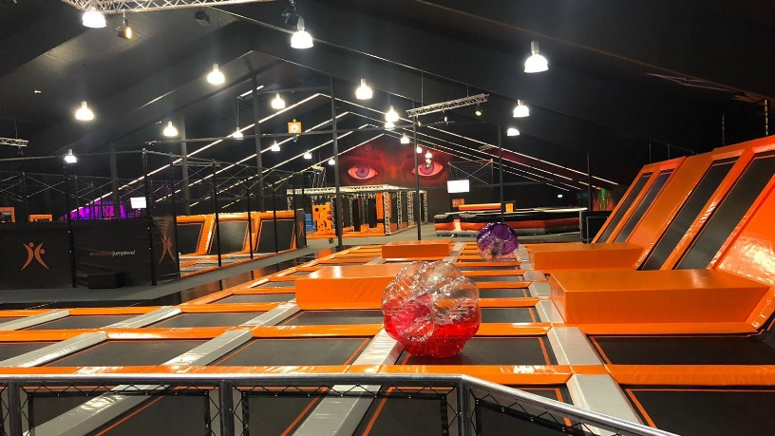
Other activities in and around Fulda
Planetarium Fulda
Virtual travel through the universe
Jump Fabrik Fulda
largest trampoline park in eastern Hesse
Wasserkuppe (Ski, Hiking,…)
Point Alpha Memorial
“The Point Alpha Memorial is an authentic scene of the Cold War and a unique testimony to four decades of contemporary history. This is where the outposts of NATO and the Warsaw Pact faced each other until 1990. The former “Observation Post Alpha” (Point Alpha for short) was one of the most important observation posts of the U.S. Armed Forces in Europe and one of the hottest spots in the Cold War. “

Slide 18
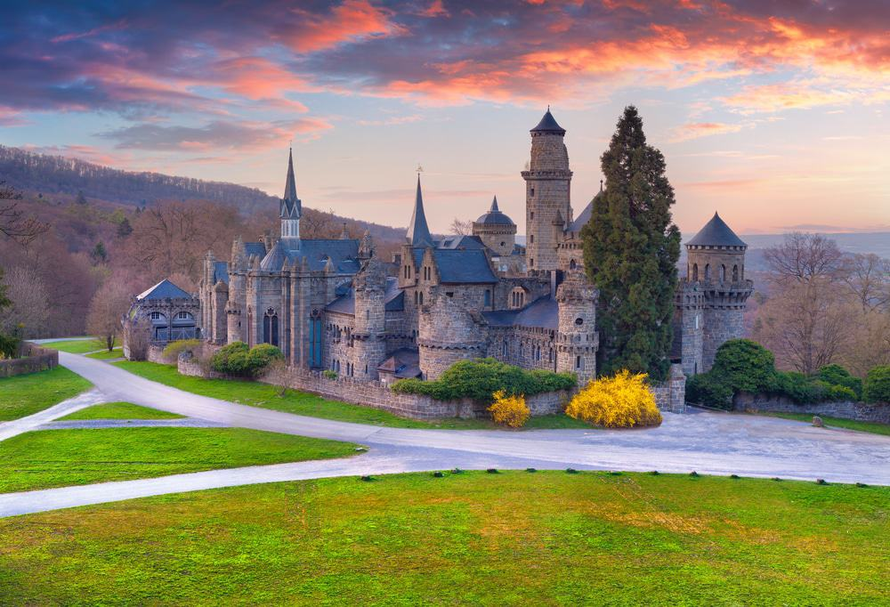
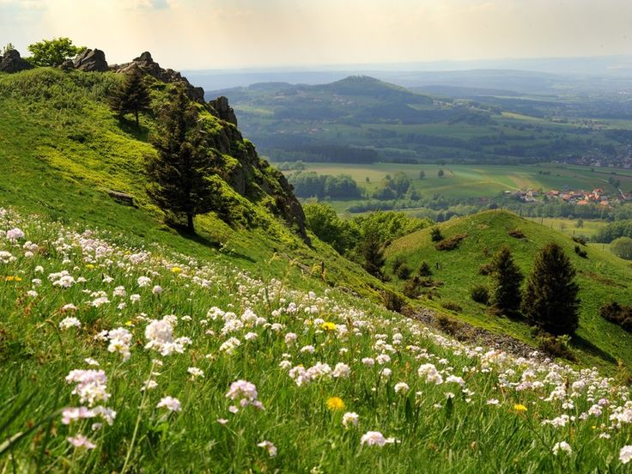
Trips outside of Fulda
City trip to Kassel
Bergpark & Herkules
Orangerie
Löwenburg
In summer 2022: Documenta (exhibition of contemporary art which takes place every five years)
City trip to Frankfurt
Main Tower
Lots of shopping options
„Dialog im Dunkeln“ (visitors are guided by blind or visually impaired experts through a lightless course with changing themed rooms)
Hiking in the Rhön UNESCO Biosphere Reserve
Check out more attractions in Hesse
https://www.komoot.com/guide/210032/attractions-in-hesse

Slide 19
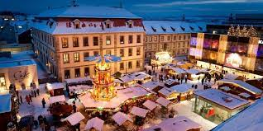
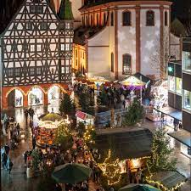
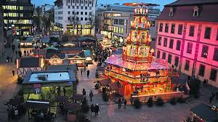
Christmas in Fulda
Fulda Weihnachtsmarkt
Christmas Markets in other cities: Kassel, Marburg, Frankfurt but also smaller cities around Fulda

Slide 20
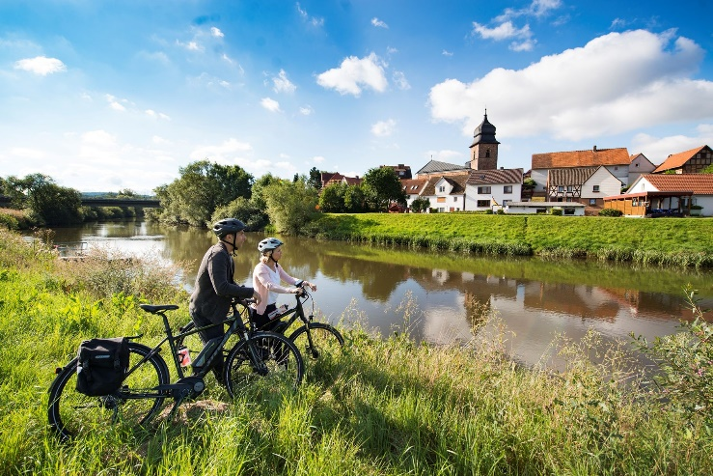
What to do and tips
Get a Bike!
It is way easier to get around with a bike, because public transport is not the best in Fulda (walking is always possible though)
Make sure to find an accommodation directly in Fulda (there are lots of smaller villages/parts around Fulda that are more difficult to reach without a car)
Dorms are good, WGs are better!
Check out different Hochschulgruppen to meet people (e.g. UNICEF, sport activity, religious groups)
Connect with locals!
They will show you around the best spots and take you to the most popular events
Go outside and explore the nature!

Slide 21
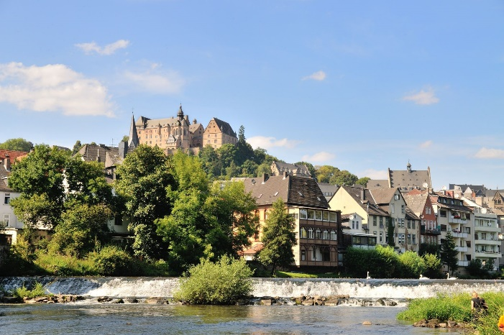
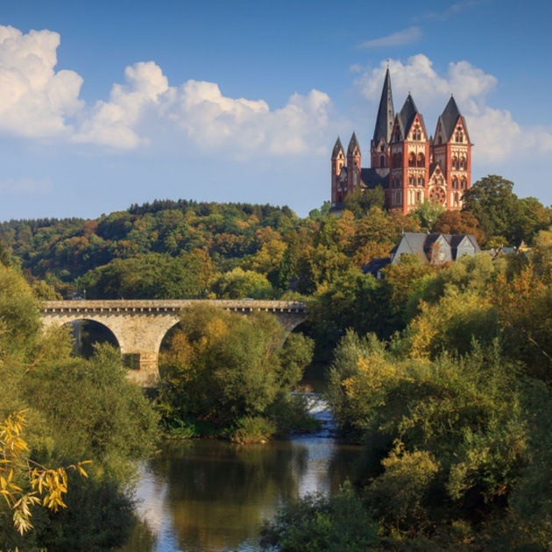
Bigger cities nearby to visit
Frankfurt am Main
Wiesbaden
Kassel
Darmstadt
Gießen
Marburg
Rotenburg an der Fulda
Limburg an der Lahn

Slide 22
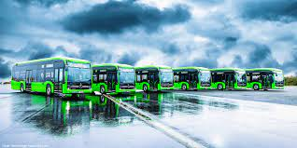
Public transport
Only busses in Fulda
Check the time (not too frequently)
Students have a semester ticket for Hessen included in their student ID card
Others: buy a ticket (either machine or online)
Check apps to see when to go and how („DB Navigator“)
ICE and IC is not included in the semester ticket
Be on time even though busses/trains do not necessarily run on time

Slide 23
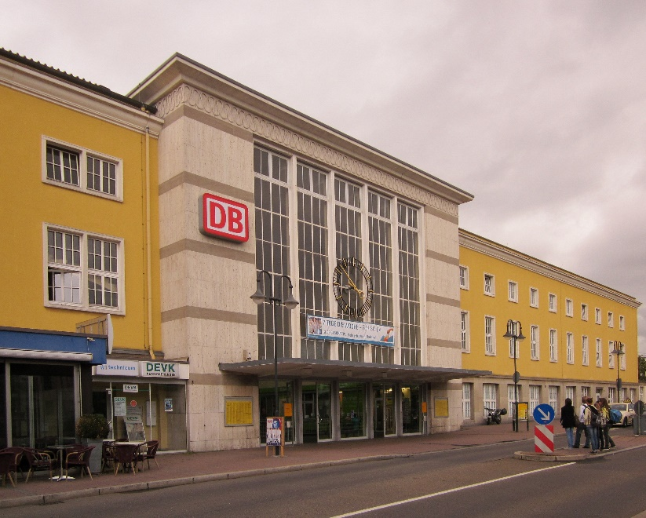
German Transport System
Deutsche Bahn (DB): main operator of German wide railway
Look out for saving prices “Sparpreis”
Regional Group Tickets
If you want to travel a lot: purchase a BahnCard for vouchers
Cheap alternatives: FlixTrain and FlixBus.
Carsharing: BlaBlaCar
Taxis are very expensive

Slide 24
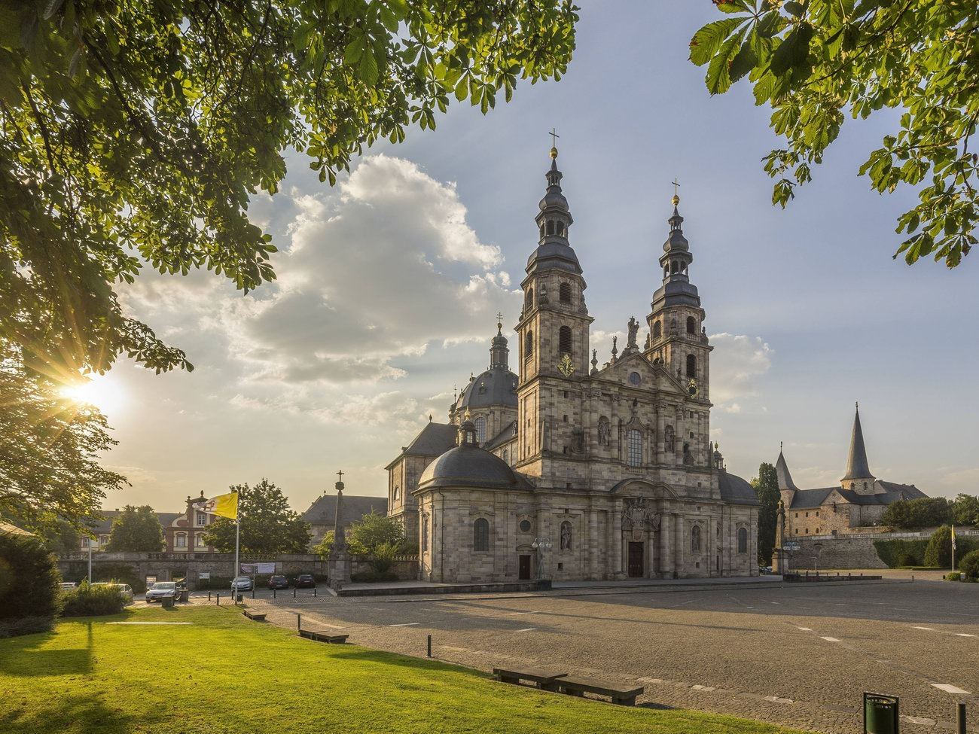
Any questions? … enjoy Fulda… and keep in mind: People make places!!
Feel free to contact: io.intern@gju.edu.jo

