Slide 1
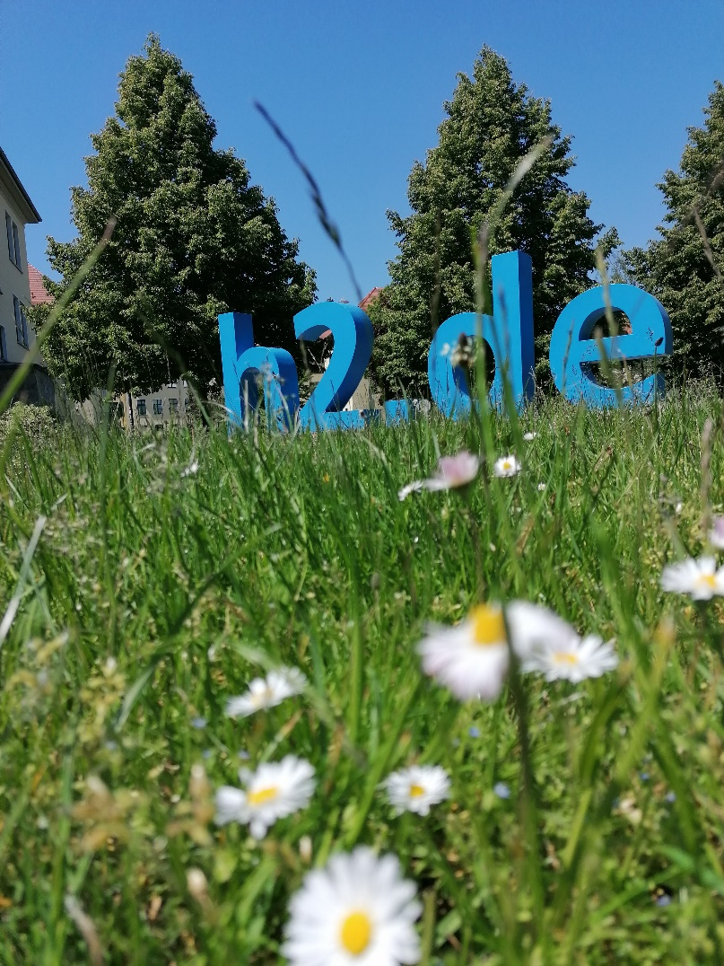
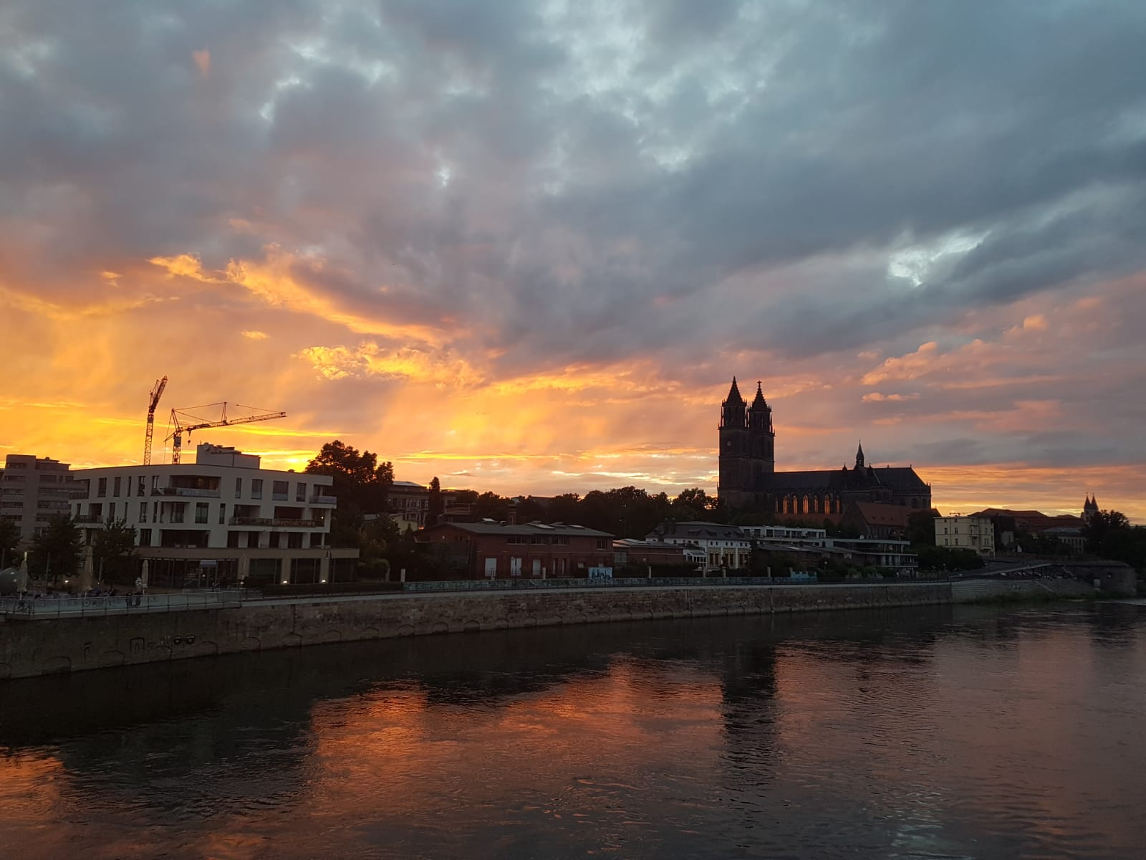
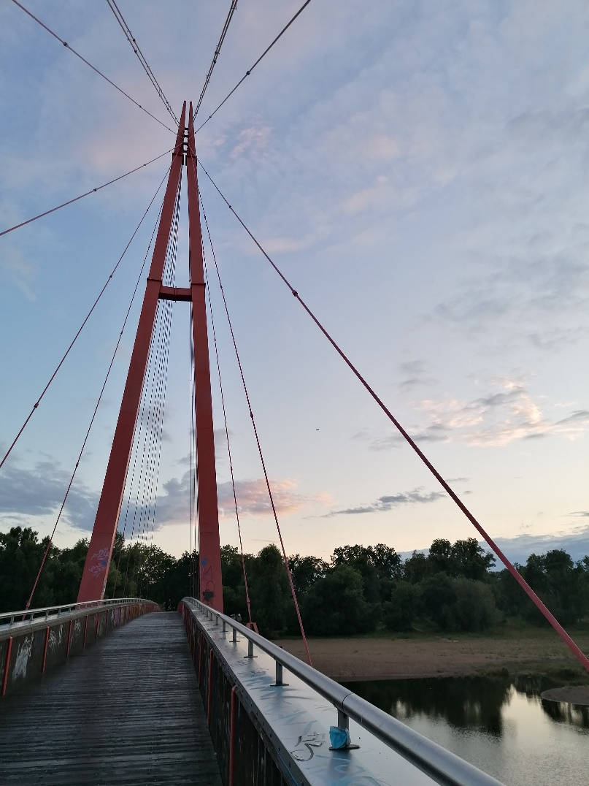
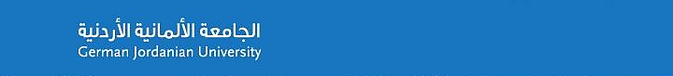
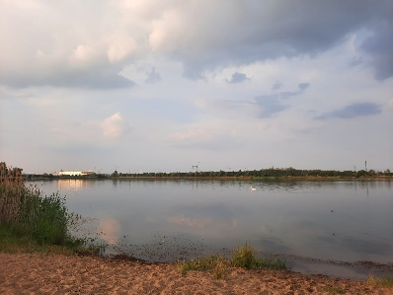
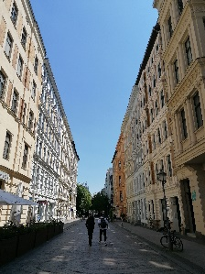
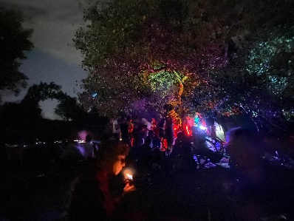
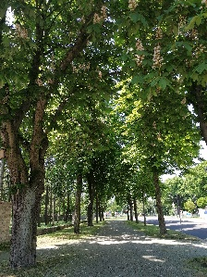
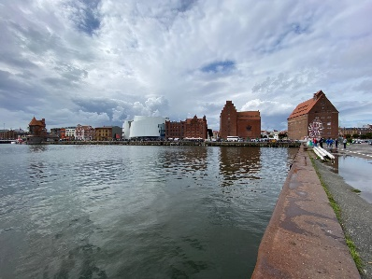
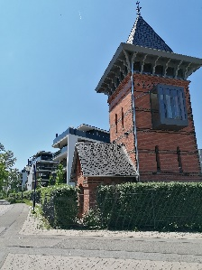
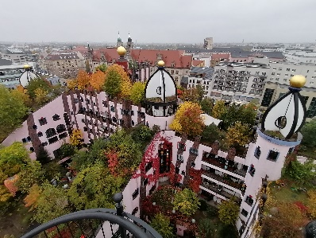
City Survival Guide
Magdeburg
Notes:
Philipp

Slide 2
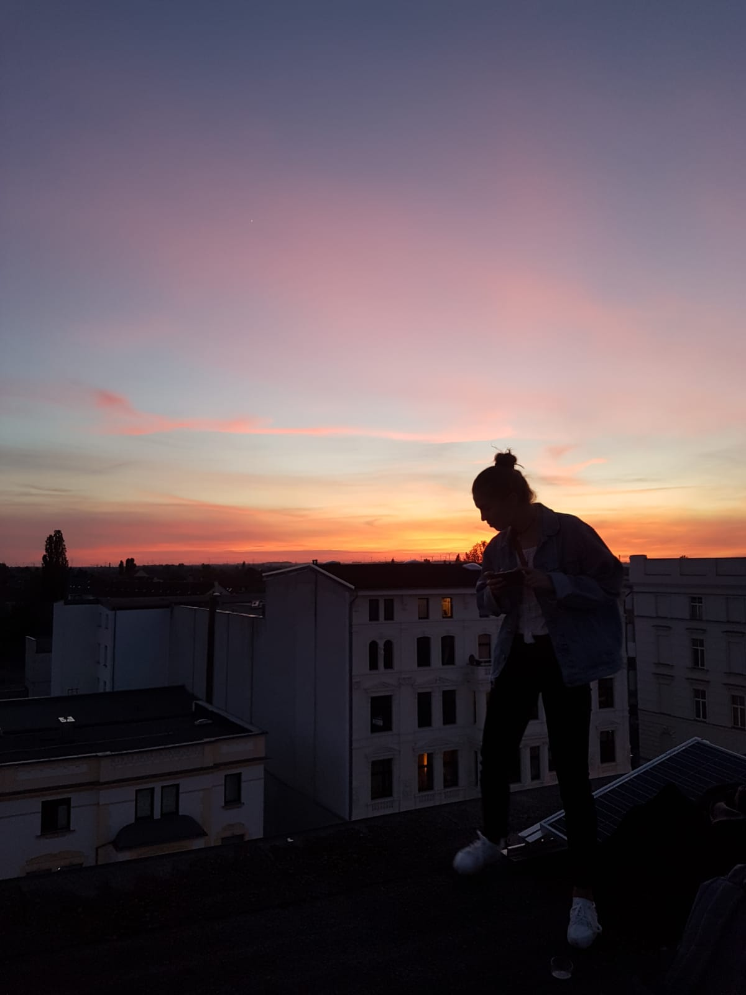
Disclaimer
The tips, recommendations and advice in this presentation are based on our own experience/opinion.
We do not want to give special ratings, but we want to provide a pleasant stay with all the beautiful aspects of Magdeburg, especially away from the typical touristy spots.

Slide 3
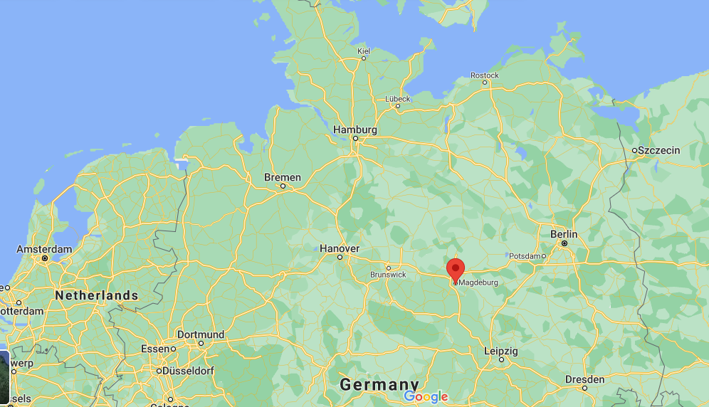

Magdeburg – the West of East Germany
https://www.german-jordanian.org/de/uebersicht.html

Slide 4
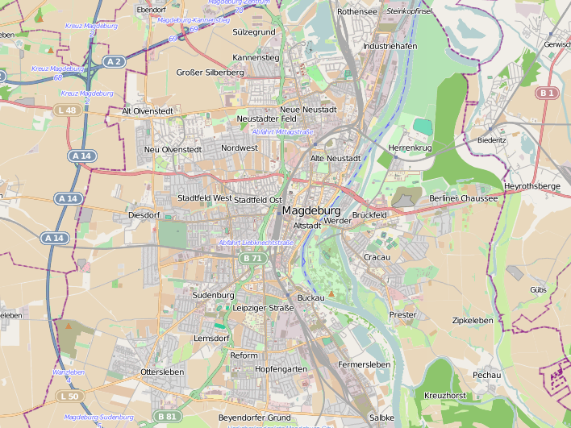
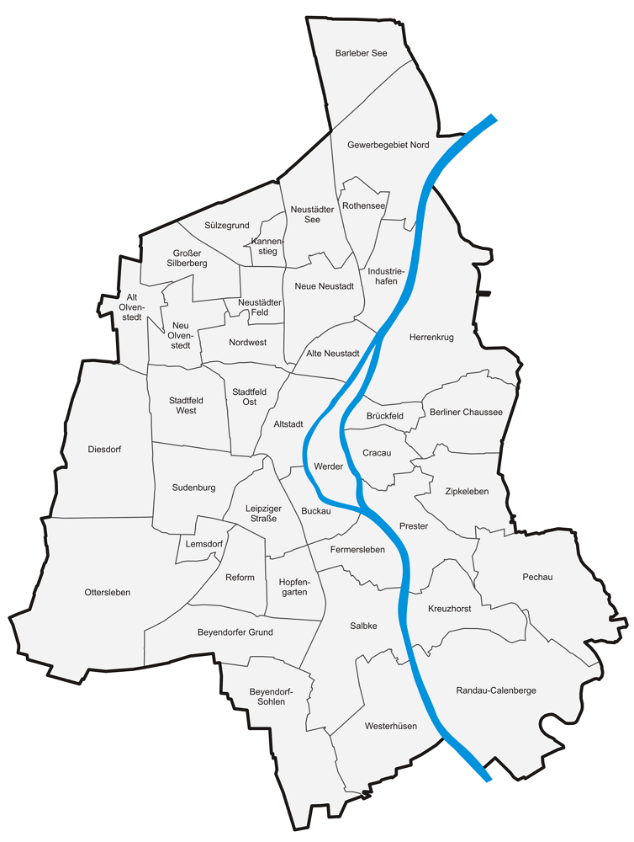

Magdeburg – Map

Slide 5
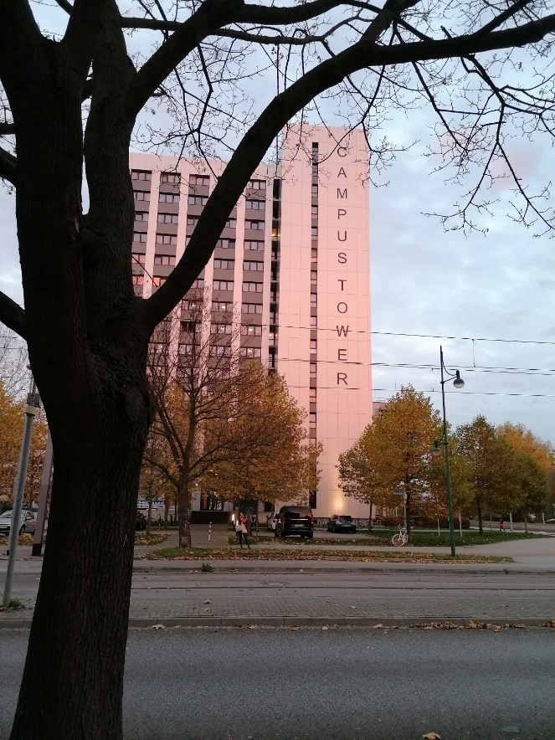
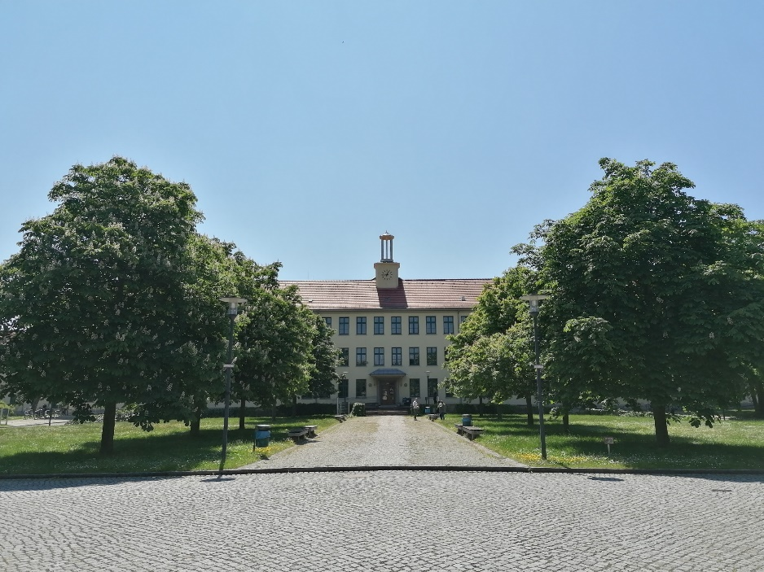
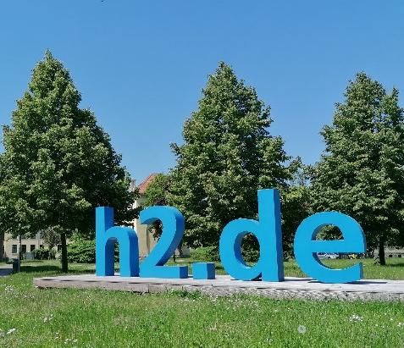
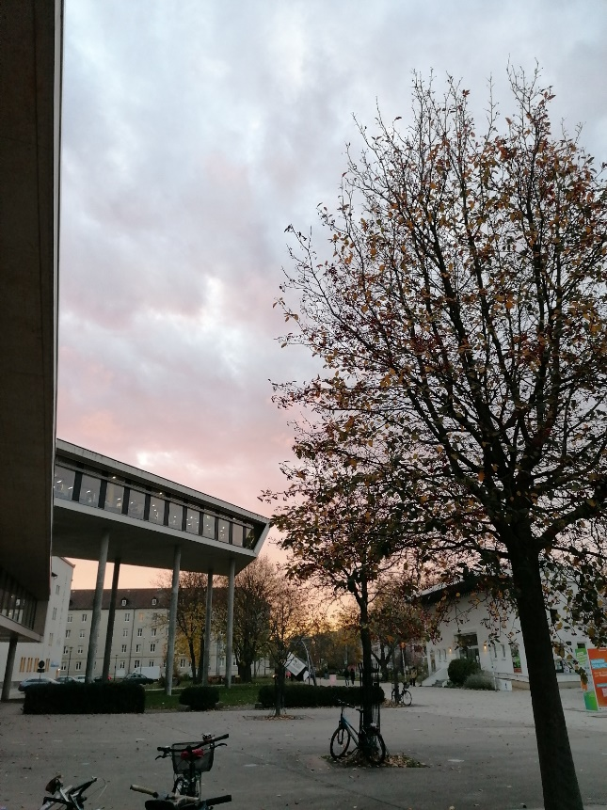
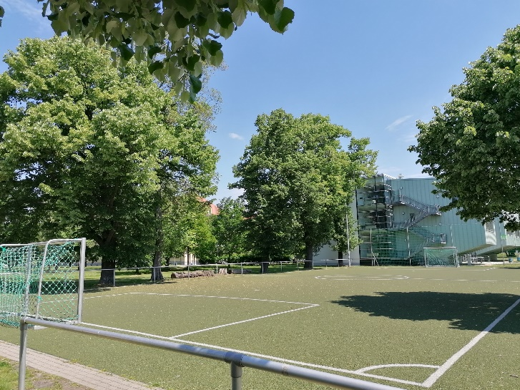
Otto-von-Guericke University
Hochschule Magdeburg-Stendal

Slide 6





Quick Facts
240.000
capital of Sachsen-Anhalt
First documented in 9th century
Largest minority are Syrian
Borders towards Niedersachsen, Brandenburg, Sachsen, Thüringen
The city of Otto: “Ottostadt Magdeburg”
Early 20th century more than 300.000 people
40 districts

Slide 7




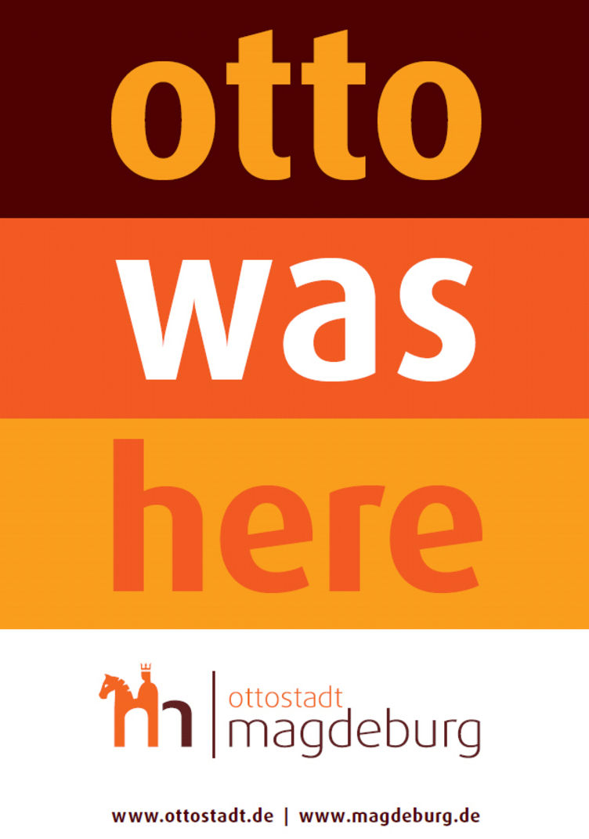




Ottostadt Magdeburg

Slide 8
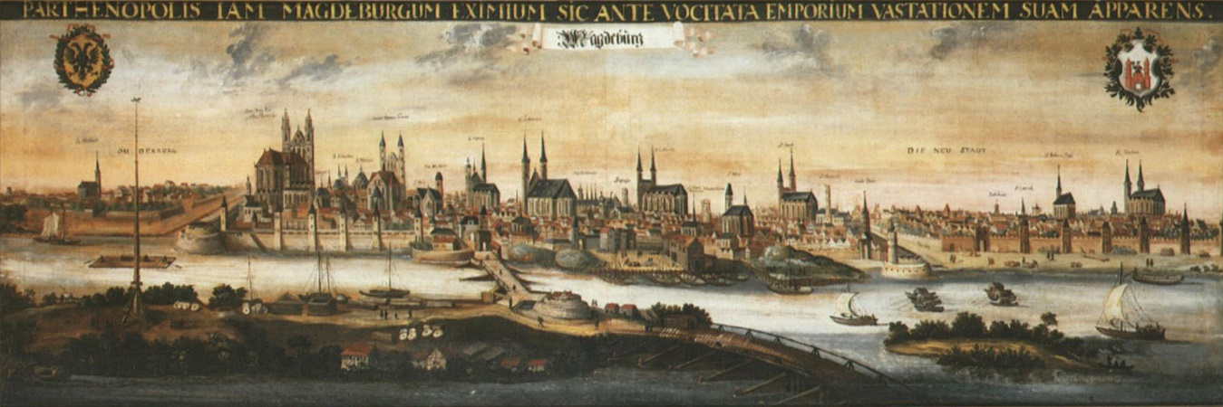
History
Magdeburg…
As Kaiserpfalz / „imperial palace“ of Otto I.
As part of Prussia
As part of the Weimarer Republic
As part of the Nazi regime
As part of East Germany (DDR)
As capital of Sachsen-Anhalt

Slide 9
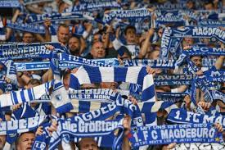
Culture
Machdeburch not Maaagdeburg: the Magdeburg Dialect
Football (1. FCM) and Handball (SCM)
  Hooligans
Old people rather grumpy and few English skills, do not take it personally!
Young people are very open minded
Rural culture in the villages around Magdeburg
Oktoberfest, Messen and Fasching
Magdeburg = MD

Slide 10
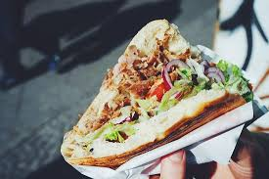
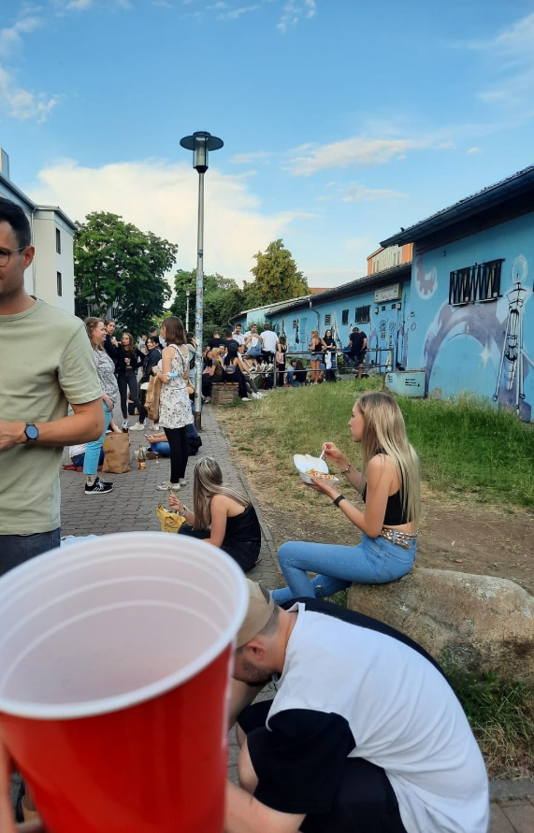
Food and drinks
Döner: Bingöl
Typical east german food: Bullette mit Mostrich, Soljanka, Gehacktesstippe, Jagdwurstschnitzel…
Bier/Radler/Alster (alcoholic drinks)
Local beer: Sudenburger Bier, Colbitzer, Ur-Kostritzer, Sternburg Bier, Brewckau
Local wine: Saale-Unstrut region, southern Sachsen-Anhalt

Slide 11
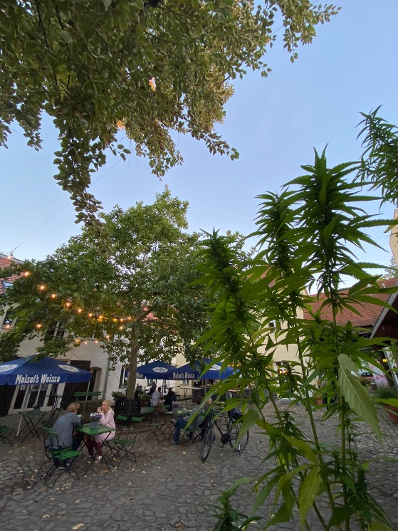
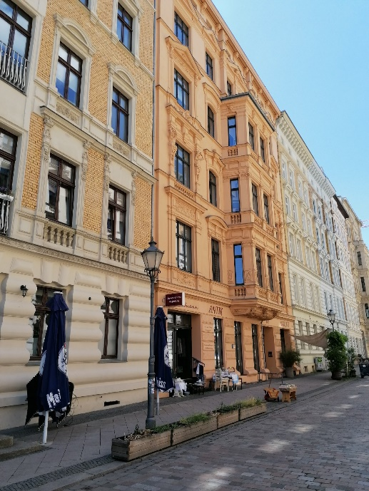
Restaurants and cafes
A lot of streetfood around Hasselbachplatz and malls (City Carre and Allee Center)
Restaurants from all over the world
  Especially asian cuisine: thai, chinese, vietnamese, japanese, indian kitchen (go to takeaway: „Flinke Pfanne“)
  also European: spanish steakhouses, greek, balkan, italian, croatian kitchen
A few vegetarian or vegan only options: Botanica, Voeneria, Dean and David
Typical german cuisine can be found in pubs / „Kneipen“ or modern big restaurants like „Alex“, „Peter Pane“ or „Magado“
Bakeries: great for breakfast or a coffee in the morning
Cafes (can be more expensive than bakeries)
  recommendation: go for cafes in the university, a lot of young people, cheap and good coffee and sweets

Slide 12
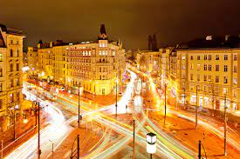
Bars
Atmosphere can differ from more relaxed to party locations
  e.g. FlowerPower is a mix of club and bar
Hasselbachplatz and Sternstraße are go to areas to find many different bars
UniTheke and Moonlight are bars located directly at the University Campus
Biergarden: Mueckenwirt, Milchkuranstalt, Treibgut, Le Frog
Sports Bars: The Fan, The Hyde, Lions City Pub…
Every district has their own local pubs
Hasselbachplatz, Magdeburg

Slide 13

Clubs
Student clubs: (Pop, oldschool, 90s+2000s)
  Baracke
  Kiste
Insel der Jugend (Electro, house, techno)
Kunstkantine (Electro, house, techno)
Datsche (House)
Geheimclub (Techno, DnB)
Prinz Club (HipHop, Pop)
Buttergasse (HipHop, Pop)
Ellen Noir (Electro)
Downtown (HipHop, Pop)
Boys‘n‘beats (Pop)
Festung Mark (all genres)
Factory (all genres)
Montego Beach Bar (all genres, reggaeton, pop)

Slide 14
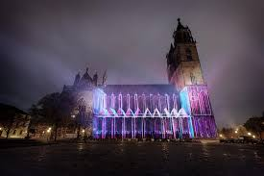
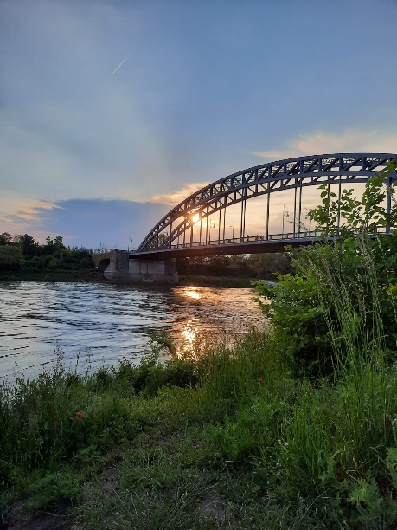

Typical must sees
Magdeburger Dom
Domplatz
Landtag
Hundertwasser Haus
Rathaus
Hasselbachplatz
Kloster unser Lieben Frauen
Johanniskirche
Hubbrücke
Sternbrücke
…so much more, buy a book guide and explore!

Slide 15
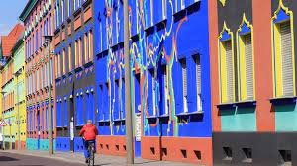
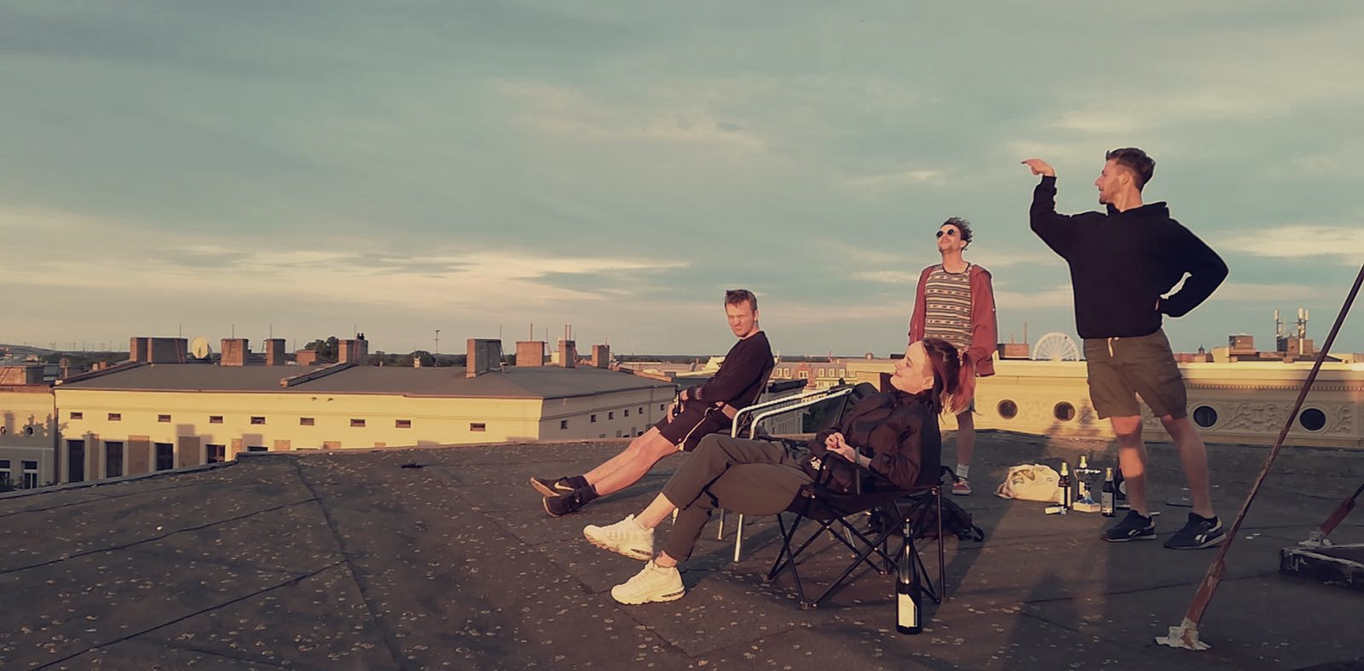
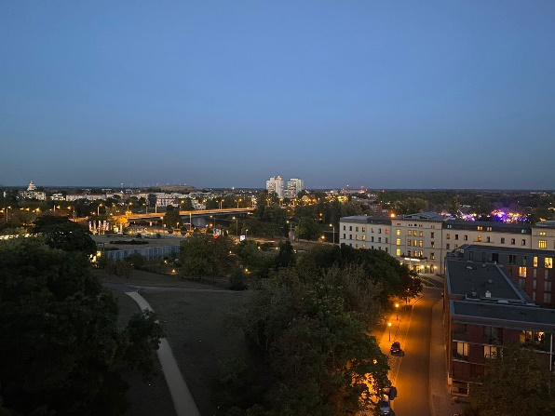
UNtypical must sees
Otto Richter Straße
Roof Tops
Moritzhof in Neustadt
Feuerwache in Sudenburg
Albin Mueller Turm (great view!)
Elbtreppen
Südspitze Stadtpark
Buckau (Klosterbergestrasse)
Wissenschaftshafen
Amusement Parks (spring and fall)
Intakt, Platz.machen, Werk4, Schauwerk. (open spaces)

Slide 16
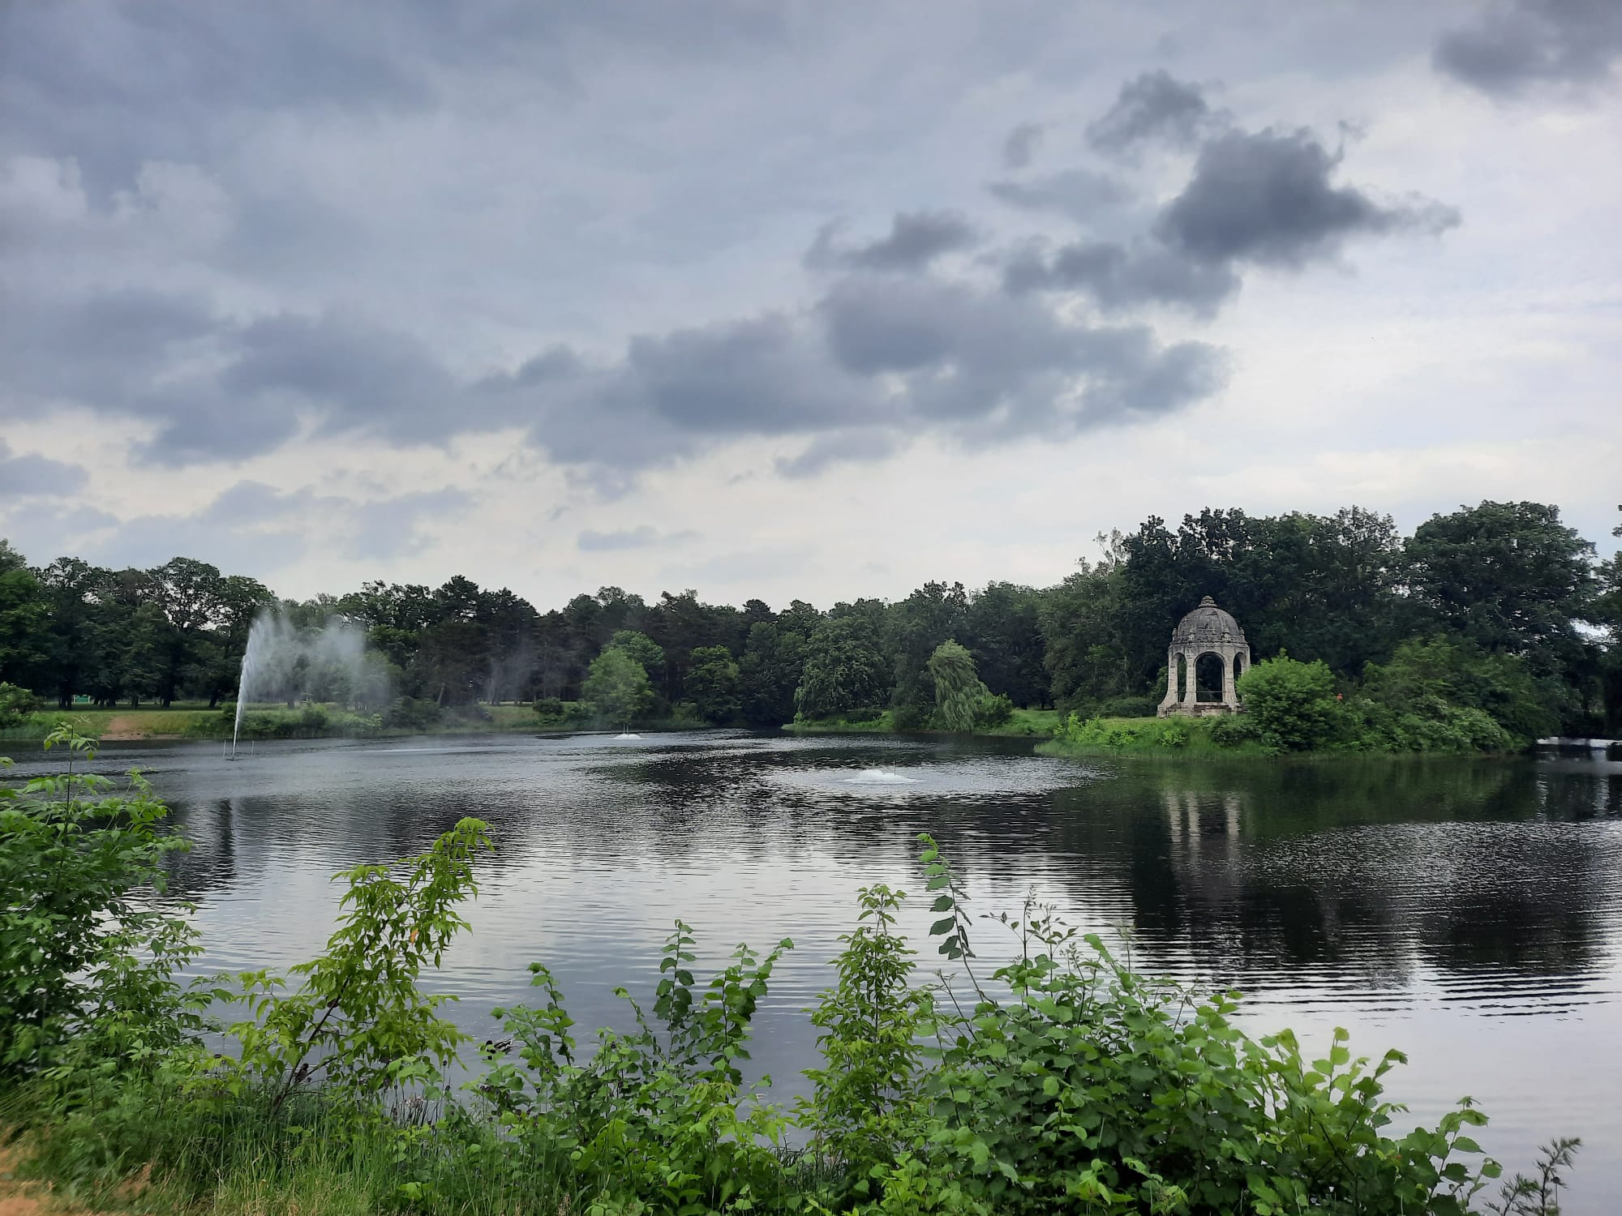
Parks
Stadtpark / Rotehorn Park
Elbauenpark
Glacis Park
Klosterbergegarten
Nordpark
Herrenkrug
Cemetries
Florapark, Bördepark
→ no parks!

Slide 17
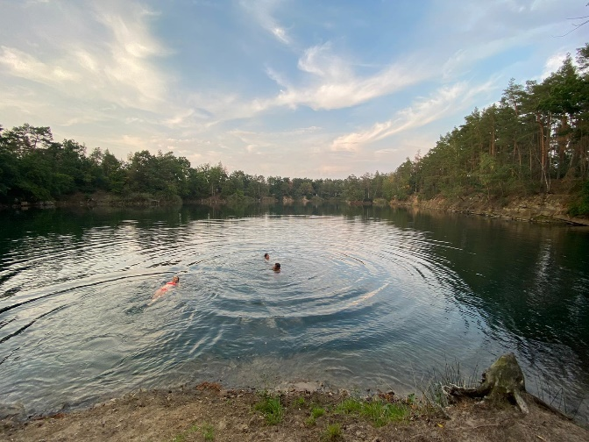
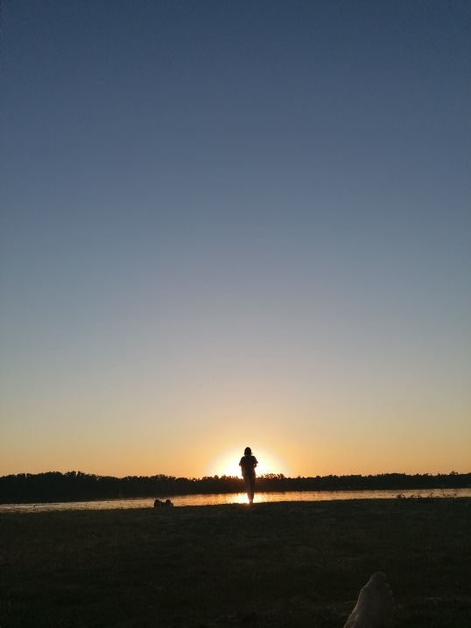
Lakes
Neustädter See
Barleber See (I and II)
Salbker See
Jersleber See
Around Gommern:
  AWG See I-III
  Silbersee
  Gruener Waldsee
  Kulksee
Do not swim in the Elbe!

Slide 18
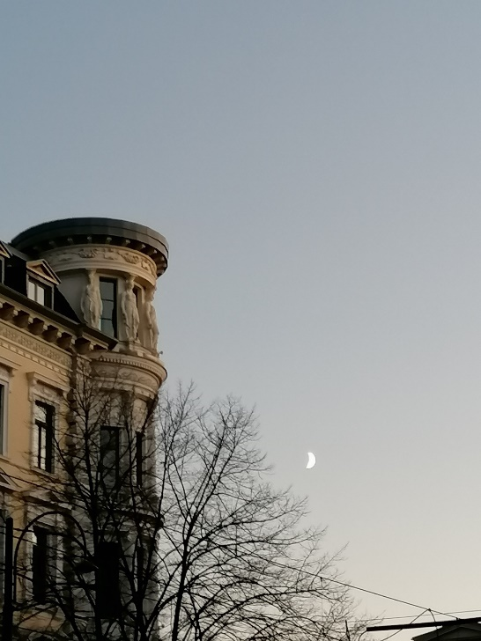
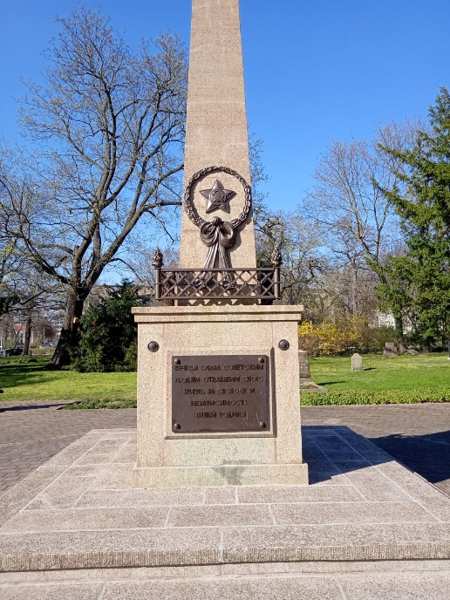
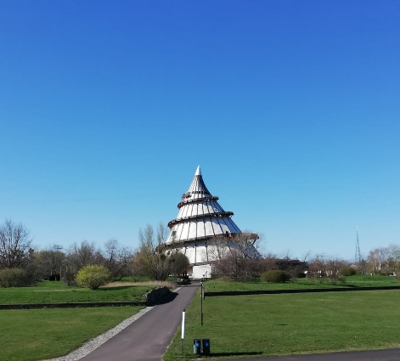
Arts, Architecture and Museums
Kulturhistorisches Museum
Dommuseum Ottonianum
Jahrtausendturm im Elbauenpark
Kloster Unser Lieben Frauen Art Museum
Tour around individual districts (by Feuerwache)
Gedenkstätte für die Opfer politischer Gewalt am Moritzplatz
Ravelin Festung
Gruenderzeit Architecture: around Hasselbachplatz
Bauhaus Architecture Exhibition
Schauwerk.
Werk4: Q.-Hof

Slide 19
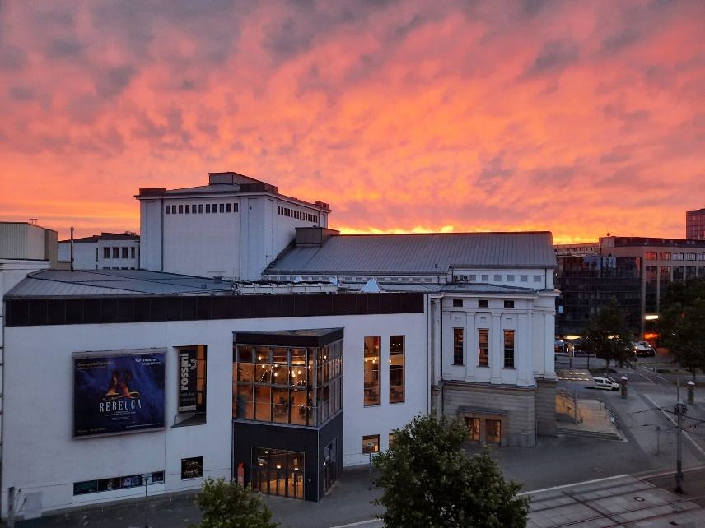
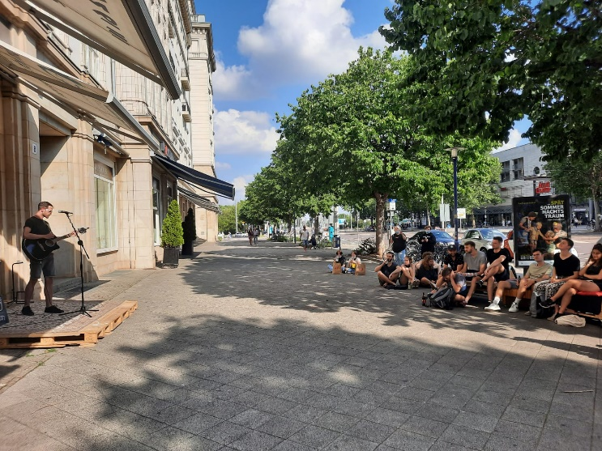
Theatres and Music
Opera House
Schauspielhaus and Theater
Theater an der Angel
Kammerspiele (“Olvenstedt probiert’s”)
Puppentheater Buckau
Kabarett “Hengstmann” or “Zwickmuehle”
InTakt
Festung Mark
Factory (concerts)

Slide 20
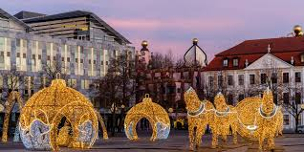
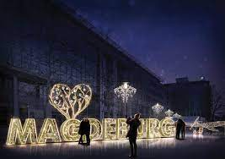
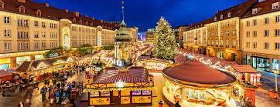
Christmas in Magdeburg
Magdeburger Weihnachtsmarkt
Many small markets
Magdeburg in Light
Ice Rinks around the City
Christmas Markets in other cities: Quedlinburg, Halle, Dresden, Leipzig, Wolfsburg, Hannover

Slide 21
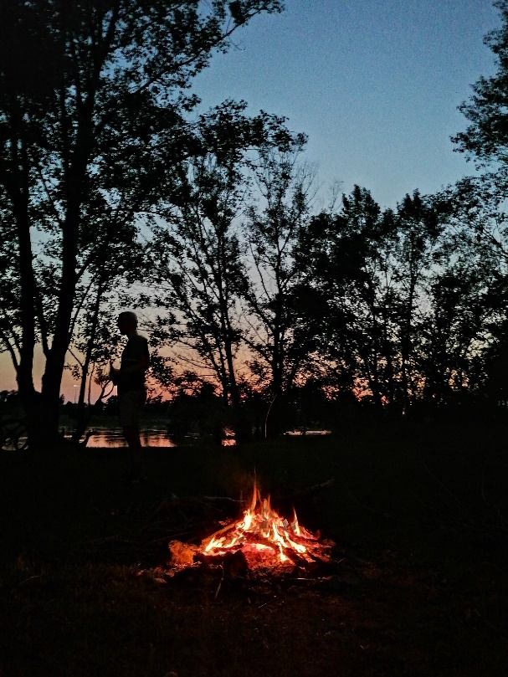
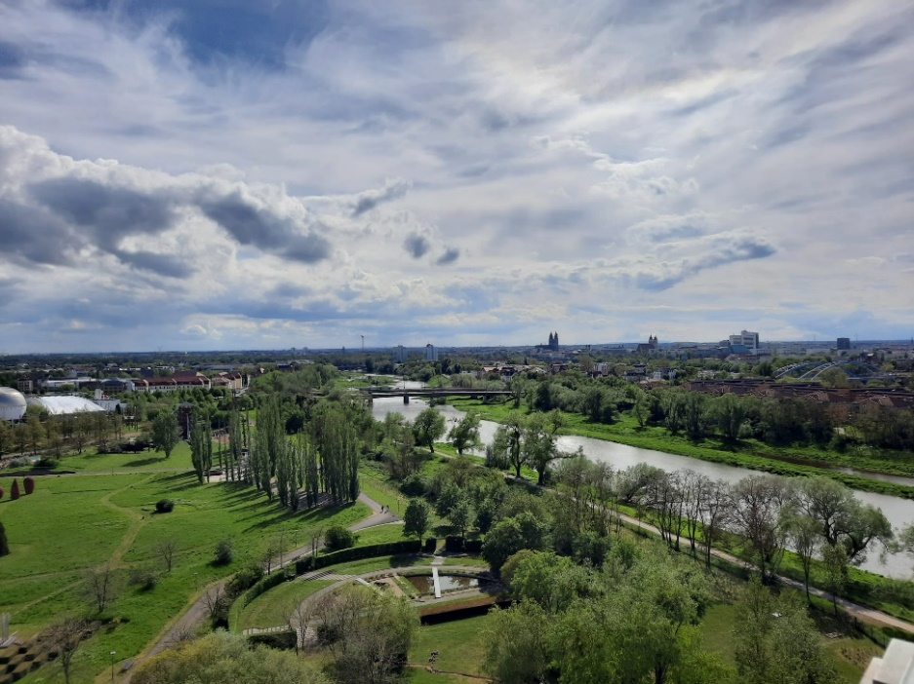
What to do and tips
Get a Bike!
  It is way easier to get around with a bike, but public transport is also well established
Get an accommodation not too far outside of the city center. Also rooms in the heart of Magdeburg are SUPER cheap.
Connect with locals!
  They will show you around the best spots and take you to the most popular events
Go outside and explore the nature!
  There are more outdoor than indoor activities in Magdeburg

Slide 22
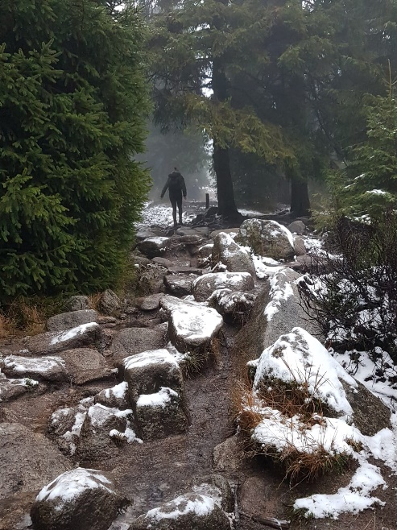
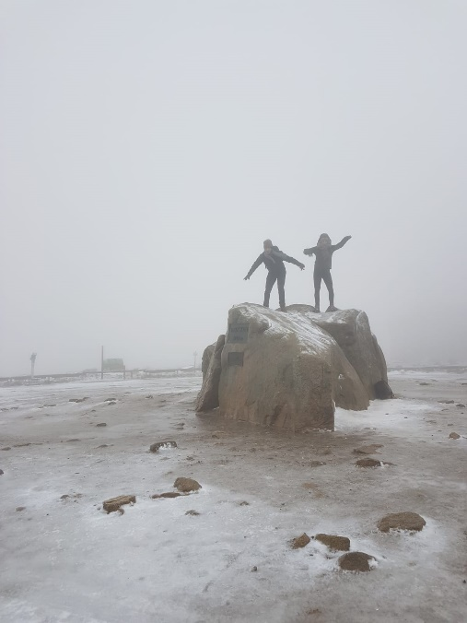
The Harz
The Brocken
Go Hiking, Biking, Climbing
Old and small towns and cities:
  Quedlinburg
  Blankenburg
  Wernigerode
Go Skiing, Sledging or Snowboarding in Winter
Bodetalsperre (Thale)

Slide 23
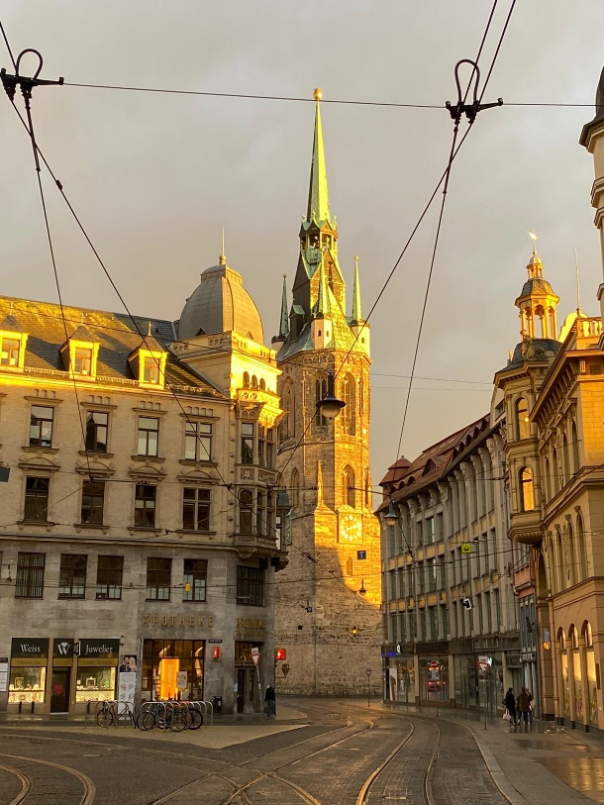
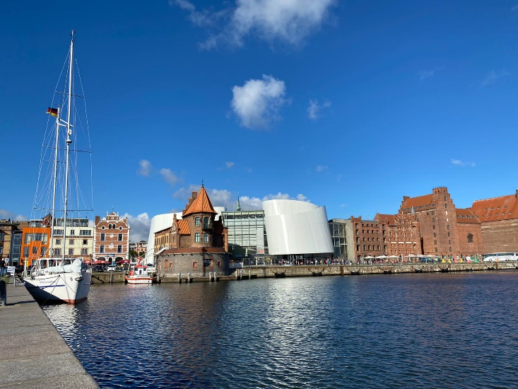
Cities nearby to visit
Halle (Saale)
Leipzig
Dresden
Berlin
Potsdam
Erfurt
Kassel
Braunschweig
Wolfsburg
Hannover
Baltic Sea: Rostock, Stralsund and Ruegen
Hamburg

Slide 24

Public transport
Students have a semester ticket included in their student ID card
  Others: buy a ticket (either machine or online)
Check apps to see when to go and how („Öffi“; „INSA“; „DB Navigator“)
Even if promised, do not always run after schedule
Many consturction works, which is why routes can differ from original plan
Night busses every hour from 11pm – 4 am

Slide 25

German Transport System
Deutsche Bahn (DB): main operator of German wide railway
  Look out for saving prices “Sparpreis”
  Regional Group Tickets
If you want to travel a lot: purchase a BahnCard for vouchers
Cheap alternatives: FlixTrain and FlixBus.
  Magdeburg → Berlin from 8 Euros
Carsharing: BlaBlaCar
Taxis are very expensive

Slide 26

Instagram ideas
If you want to get more ideas where to go and what to do, here are some suggestions:
@magdeboogie
@visit.magdeburg
@magdeburg2030
@reiseland_sachsen_anhalt
@kultursommermd
@love_foundation_magdeburg
@kultur.anker
@sachsenanhaltvision
@magdeburg_kulinarisch
@moritzhof.magdeburg

Slide 27

Any questions?
… enjoy Machdeburch!
Feel free to contact: io.intern@gju.edu.jo

